Slide 1


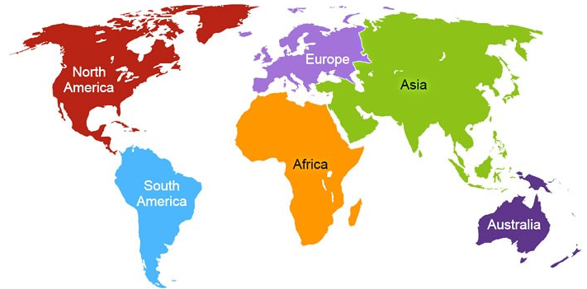


H2K Infosys is business based in Atlanta, Georgia – United States
Providing World Class Live Online, Onsite & Video based I.T. training on
Real Time Projects | Job Placement Assistance | Tech Support
www.H2KINFOSYS.com
USA - +1-(770)-777-1269
Training@H2KInfosys.com / H2KInfosys@Gmail.com

Slide 2


Slide 3
H2K INFOSYS PROVIDES WORLD CLASS SERVICES IN
IT Trainings
with Real time Project Work
for
Corporates
&
Individuals
Software Design,
Development,
QA – Manual, Automation &
Performance Testing,
Maintenance.
IT Staff Augmentation
Job Placement Assistance
Tech Support
Special IT Training for MS Students in USA & other countries

Slide 4
What Is Test Automation
Test Automation is the use of special software to control execution of test and comparison of actual outcomes with predicted outcomes.
In simple terms, Test Automation make the manual test procedures to be executed automatically.

Slide 5



Why Test Automation ?
Manual Testing:
Is time consuming
Offers low reliability
Has high risk of human error
Test Automation provides:
Speed
High reliability
Coverage
Repeatability
Reusability
Make the testing procedures systematic, consistent and 100% reproducible
Minimize the error-prone manual testing

Slide 6






Benefits of Test Automation
Test Automation offers the following benefits:
Increased Productivity
Standardized Processes
Improved Time to Market
Benefits
Consistency of Compliance
Lower Total Cost of Ownership (TCO)
Better Quality

Slide 7
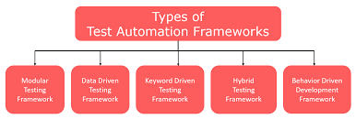
Test Automation Framework
Test Automation Framework is a set of guidelines for creating and designing Test cases. Frameworks helps testers to use resources more efficiently.

Slide 8
Test Automation tools
Different Test Automation tools:
Selenium
UFT
Test Automation Tools
WebServices
RFT
Appium
TestComplete

Slide 9
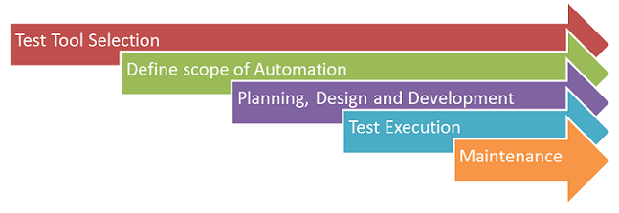
Test Automation Process

Slide 10
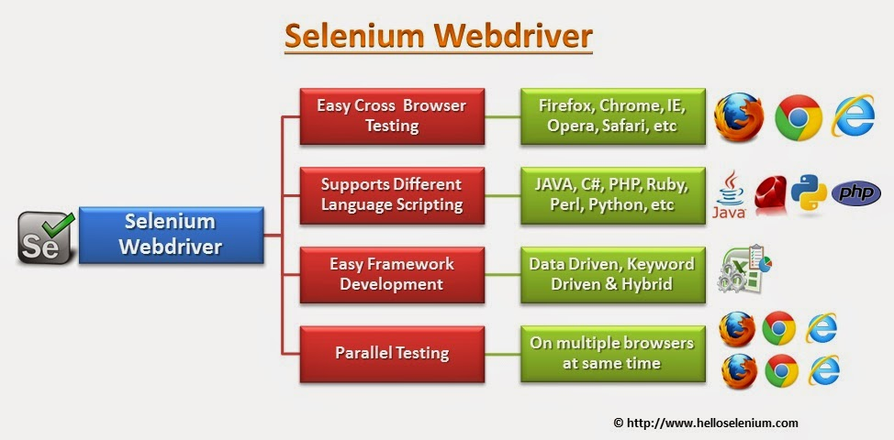
Test Automation with Selenium..
Selenium is a portable software testing framework for web applications.
In 2004 invented by Jason R. Huggins and team. And its Original name is JavaScript Functional Tester [JSFT]

Slide 11
Types of Testing Supported bY Selenium
Selenium supports 2 types of testing:
Functional Testing: Testing each and every function inside an application to ensure that it is working as per the requirement.
Regression Testing: Re-testing of all the functionality when a new feature is added in the application to ensure all the functions work as expected.

Slide 12
Selenium vs other testing tools
Features | UFT | IBM RFT | Selenium | TestComplete
License | Required | Required | Open source | Required
Cost | High | High | Free | High
Customer Support | Dedicated HPsupport | Dedicated IBM support | Online source community | Dedicated support available
H/W resource consumption during script execution | High | High | Low | High
coding experience | Not much | Required | Required | Required
Environment Support | Windows | Windows | Windows/Mac/Linux | Windows
Language support | VB Script | Java and C# | Java, Ruby, python, C#,perl,PHP,JavaScript | VB Script,JS script, Delphi, C# Script

Slide 13
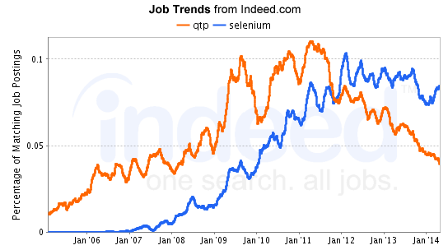
Career and Industry Demand-Selenium Web Driver
There has been a significant increase/demand in jobs of software professionals with knowledge in automation and selenium Testing.

Slide 14
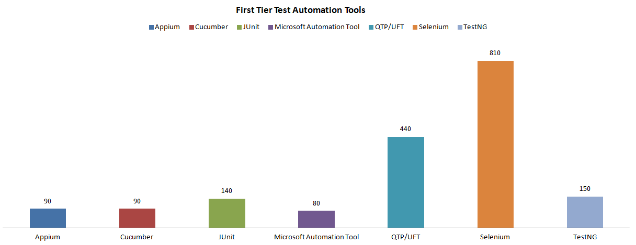
Career and Industry Demand-Selenium Web Driver
Jobs and Industry Demands among different Automation Tools
Demands in jobs of software professionals with knowledge in selenium is more when compared to other Test Automation tools

Slide 15
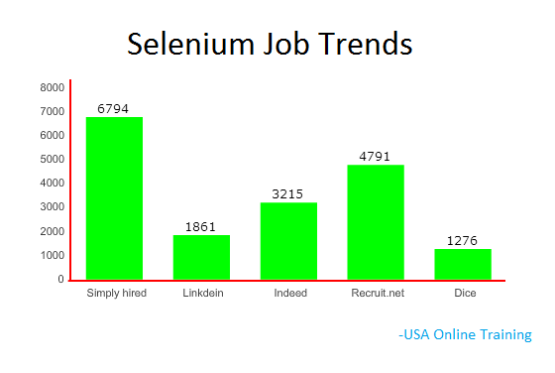
Career and Industry Demand-Selenium Web Driver
Selenium Job Trends in different Job portals
Lets discuss the number of Job opportunties and trends on different job portals in the industry.

Slide 16
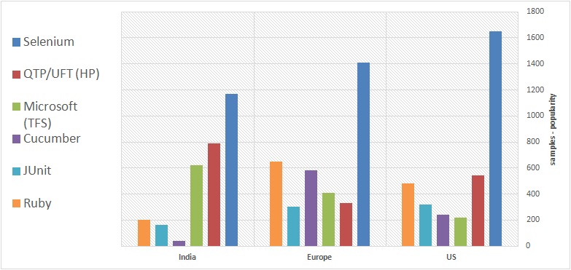
Career and Industry Demand-Selenium Web Driver
Selenium popularity in comparision to other Test Automation Tools
Among different countries here are the trends of Selenium popularity with other automation tools.

Slide 17
Test Automation with Selenium..
Pre-requisites:
Basic knowledge on Testing frameworks and process.
Basic knowledge on any scripting language supported by Selenium.
Basic knowledge on different browsers. - chrome browser, FF
Pre-requisite Software & Tools:
Java Environment Set Up version >=1.8
Eclipse IDE
Selenium WebDriver(latest version)

Slide 18
Selenium Components
Selenium IDE
Selenium WebDriver
Selenium RC
Selenium Grid

Slide 19
Why Selenium IDE
Which Automation tool to use when you want to create test cases and test suits for a website ?
Which tool to choose when you have limited knoweldge on programming language ?
Which is the easy to use tool in the market for Automation?
Automation tool for UI based application testing?
SELENIUM IDE - is the solution to all these questions..

Slide 20
Selenium IDE
Selenium IDE - Integrated Development Environment.
Its a record and play back tool.
It is a chrome/Firefox plugin tool.
You can create and edit your test cases and test suites.

Slide 21
Selenium WebDriver
WebDriver is a web automation framework that allows you to execute your tests against different browsers.
WebDriver also enables you to use a programming language in creating your test scripts
Following programming languages are supported by WebDriver: Java,.Net,PHP,Python,Perl,Ruby.
WebDriver is faster as it directly interacts with the browser.
WebDriver interacts with page elements in a more realistic way
WebDriver API commands are much simpler and easy to understand.

Slide 22
Selenium WebDriver - Advantages
It is open source tool, anyone can download & use
It supports various operating environments (Windows, Linux, Mac etc...)
It supports various programming languages to create and execute Tests
It supports all popular web browsers
It supports parallel test execution
It uses less Hardware resources as compare to other popular tools like ...QTP/UFT

Slide 23
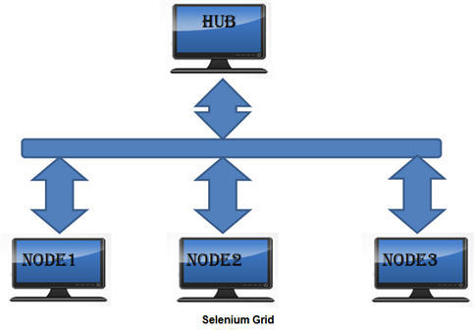
Selenium Grid
Selenium Grid is a part of the Selenium Suite that specializes in running multiple tests across different browsers, operating systems, and machines in parallel.
Selenium Grid uses a hub-node concept where you only run the test on a single machine called a hub, but the execution will be done by different machines called nodes.

Slide 24
Frameworks in Selenium
There are mainly three type of frameworks created by Selenium WebDriver :
Data Driven Framework
Hybrid Framework
Keyword Driven Framework

Slide 25
Advantages of Using Selenium:-
Simple and powerful document object model (DOM) level testing, can be used for continuous integration with agile projects.
Has great extensibility and flexibility, along with its tight integration with the browser unmatched by available proprietary tools.
Supports multiple browsers such as Internet Explorer, Fire fox, Safari or Opera on Windows, Mac OS X and Linux.
Wires Object Oriented Programming languages like JAVA, .NET, Ruby, Perl, PHP, etc.
Provides the option of using wide range of IDEs such as Eclipse, Netbeans, Visual Studio etc depending on the choice of development language.

Slide 26

Test Automation & Selenium Training
A detailed training in Selenium and test Automation will boost up your career opportunities in Software Industry.

Slide 27
Thank you
Your feedback is highly important to improve our course
material and teaching methodologies. Please email your suggestions.
USA: +1-(770)-777-1269
Training@H2KInfosys.com H2KInfosys@Gmail.com
H2K Infosys is e-Verified business based in Atlanta, Georgia – United States
H2K Infosys acknowledges the proprietary rights of the trademarks and product names of other companies mentioned in this document.

Slide 28

DISCLAIMER
H2K Infosys, LLC (hereinafter “H2K”) acknowledges the proprietary rights of the trademarks and product names of other companies mentioned in any of the training material including but not limited to the handouts, written material, videos, power point presentations, etc. All such training materials are provided to H2K students for learning purposes only. H2K students shall not use such materials for their private gain nor can they sell any such materials to a third party. Some of the examples provided in any such training materials may not be owned by H2K and as such H2K does not claim any proprietary rights for the same. H2K does not guarantee nor is it responsible for such products and projects. H2K acknowledges that any such information or product that has been lawfully received from any third party source is free from restriction and without any breach or violation of law whatsoever.

Slide 29
Test Automation Types
Automated Unit Testing: Testing at code level which involves identifying bugs in the functions, methods or routines.
Example: Junit with Selenium.
Automated API Testing: Testing the complaince and security issues
Example: SOAPUI tool
Automated GUI Testing: Testing of User Interface of an application. Mostly used in Rression testing scenarios.
Example: Selenium, Testcomplete tools

Slide 30
Types of Testing Supported bY Selenium
Selenium supports 2 types of testing:
Functional Testing: Testing each and every function inside an application to ensure that it is working as per the requirement.
Regression Testing: Re-testing of all the functionality when a new feature is added in the application to ensure all the functions work as expected.

Slide 31
Selenium vs other testing tools
Features | UFT | IBM RFT | Selenium | TestComplete
License | Required | Required | Open source | Required
Cost | High | High | Free | High
Customer Support | Dedicated HPsupport | Dedicated IBM support | Online source community | Dedicated support available
H/W resource consumption during script execution | High | High | Low | High
coding experience | Not much | Required | Required | Required
Environment Support | Windows | Windows | Windows/Mac/Linux | Windows
Language support | VB Script | Java and C# | Java, Ruby, python, C#,perl,PHP,JavaScript | VB Script,JS script, Delphi, C# Script

Slide 32
Types of Tests
Functional Tests: Testing of functional Requirements for an application
Automation of functional Tests means writing of scripts to valudate the functionality expected from the application.
Non Functional Tests : Non Functional tests means testing of non functional requirements of an application.
Testing of requirements related to performance, security, database and so on.

